Slide 1

Geometry
Unit 2, Lesson 3 Logical Conclusions Volume 1, pg. 94

Slide 2


Benchmark
MA.912.LT.4.10
Judge the validity of arguments and give counterexamples to disprove statements.
volume 1, pg. 94

Slide 3
Integrated Mathematical Thinking and Reasoning Standards
MA.K12.MTR.1.1 Actively participate in effortful learning both individually and collectively.
MA.K12.MTR.2.1 Demonstrate understanding by representing problems in multiple ways.
MA.K12.MTR.4.1 Engage in discussions that reflect on the mathematical thinking of self and others.
MA.K12.MTR.5.1 Use patterns and structure to help understand and connect mathematical concepts.
volume 1, pg. 94

Slide 4

Learning Targets
I can complete an argument that leads to a logical conclusion.
I can determine if an argument leads to a logical conclusion.
volume 1, pg. 94

Slide 5

Warm-Up
volume 1, pg. 94

Slide 6
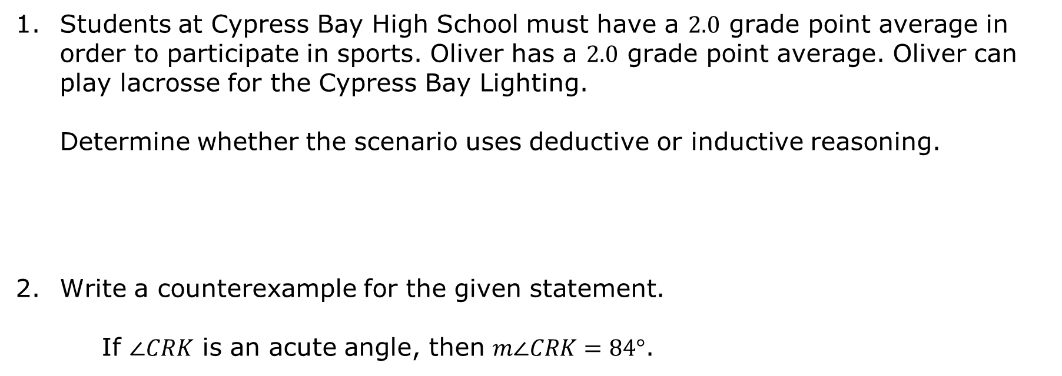
2.3.1 Warm-Up: Bell Work
Students at Cypress Bay High School must have a $2.0$ grade point average in order to participate in sports. Oliver has a $2.0$ grade point average. Oliver can play lacrosse for the Cypress Bay Lighting.
Determine whether the scenario uses deductive or inductive reasoning.
Write a counterexample for the given statement.
If $∠CRK$ is an acute angle, then $m∠CRK=84°$.
volume 1, pg. 94

Slide 7

Collaboration
volume 1, pg. 95

Slide 8

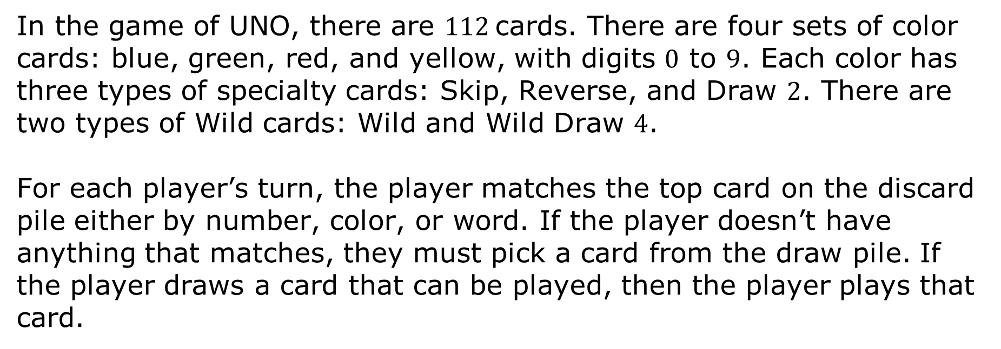
2.3.2 Collaboration: Logical Arguments Using UNO
In the game of UNO, there are $112$cards. There are four sets of color cards: blue, green, red, and yellow, with digits $0$ to $9$. Each color has three types of specialty cards: Skip, Reverse, and Draw $2$. There are two types of Wild cards: Wild and Wild Draw $4$.
For each player’s turn, the player matches the top card on the discard pile either by number, color, or word. If the player doesn’t have anything that matches, they must pick a card from the draw pile. If the player draws a card that can be played, then the player plays that card.
volume 1, pg. 95

Slide 9
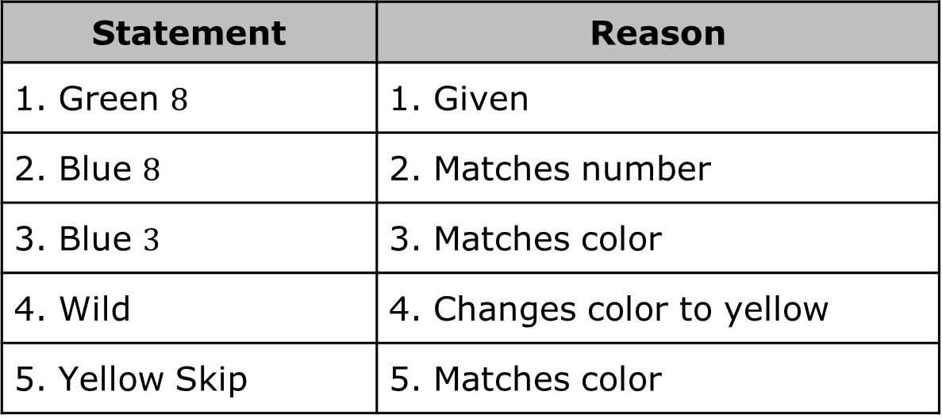
Work with your partner to determine if the series of steps is possible in the game. Each statement represents a card played.
Statement | Reason
1. Green $8$ | 1. Given
2. Blue $8$ | 2. Matches number
3. Blue $3$ | 3. Matches color
4. Wild | 4. Changes color to yellow
5. Yellow Skip | 5. Matches color
volume 1, pg. 95

Slide 10
Add three additional statements and provide the reason.
Statement | Reason
6. | 6.
7. | 7.
8. | 8.
Ask your partner to verify that your steps are valid.
volume 1, pg. 95

Slide 11
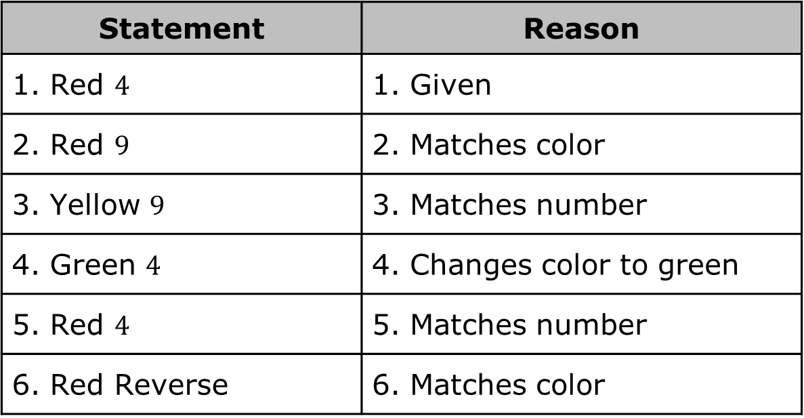
The series of steps shown is not possible. Correct the error.
Ensure that you and your partner found the same error and that the corrections are both correct.
Statement | Reason
1. Red $4$ | 1. Given
2. Red $9$ | 2. Matches color
3. Yellow $9$ | 3. Matches number
4. Green $4$ | 4. Changes color to green
5. Red $4$ | 5. Matches number
6. Red Reverse | 6. Matches color
volume 1, pg. 95

Slide 12
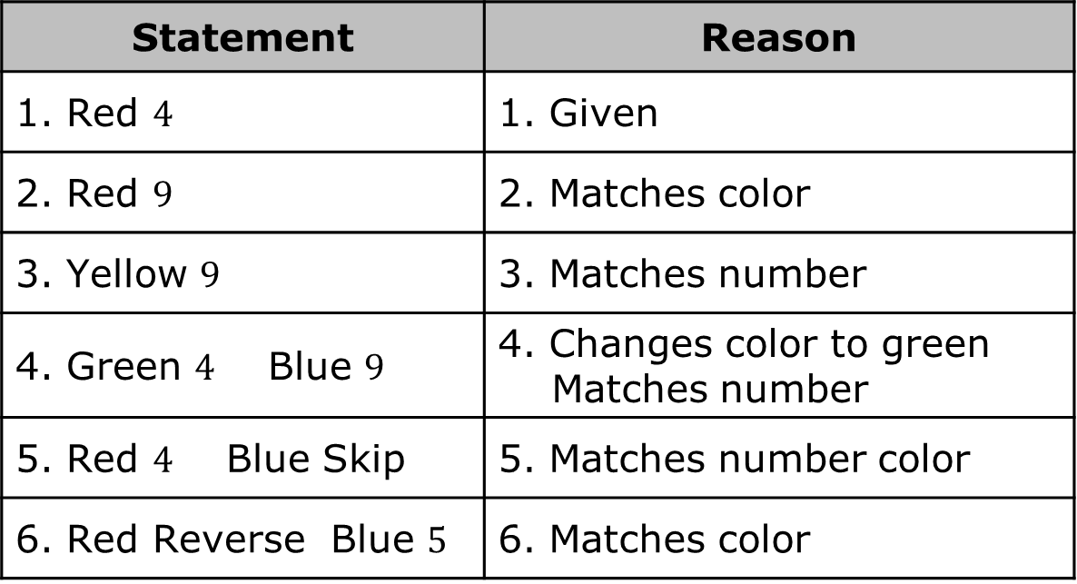
Yolanda made the following corrections.
Explain why you or your partner’s corrections may not match Yolanda’s corrections.
Statement | Reason
1. Red $4$ | 1. Given
2. Red $9$ | 2. Matches color
3. Yellow $9$ | 3. Matches number
4. Green $4$ Blue $9$ | 4. Changes color to green Matches number
5. Red $4$ Blue Skip | 5. Matches number color
6. Red Reverse Blue $5$ | 6. Matches color
volume 1, pg. 95

Slide 13
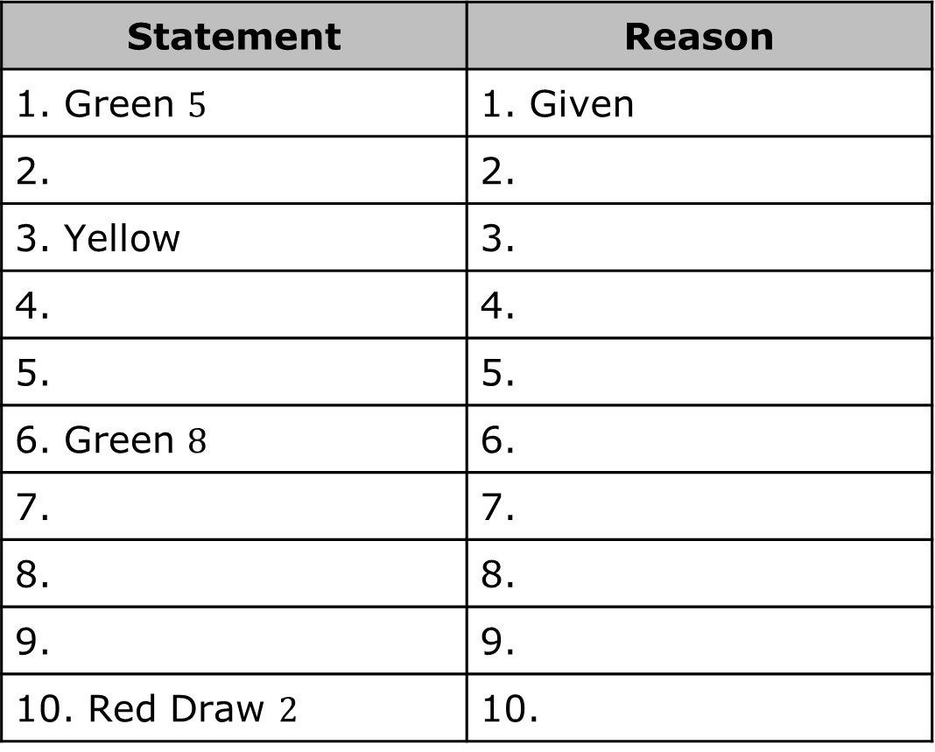
Work with your partner to create a logical argument that leads to a Red Draw $2$.
Statement | Reason
1. Green $5$ | 1. Given
2. | 2.
3. Yellow | 3.
4. | 4.
5. | 5.
6. Green $8$ | 6.
7. | 7.
8. | 8.
9. | 9.
10. Red Draw $2$ | 10.
volume 1, pg. 96

Slide 14
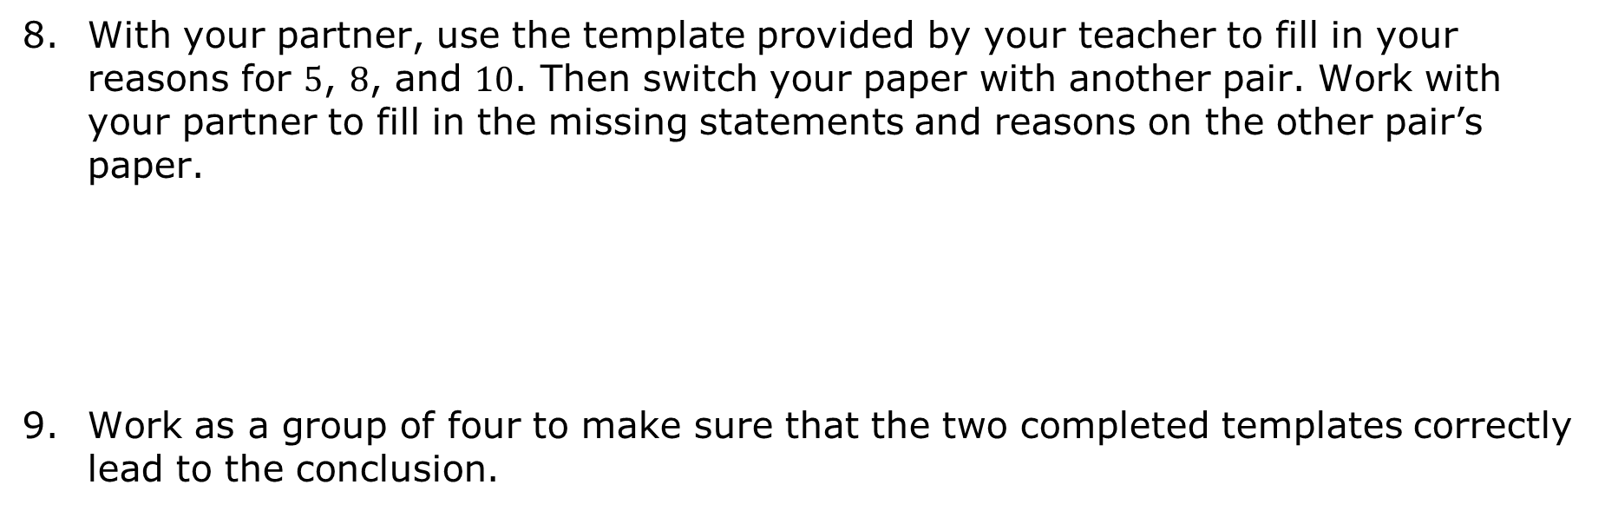
With your partner, use the template provided by your teacher to fill in your reasons for $5$, $8$, and $10$. Then switch your paper with another pair. Work with your partner to fill in the missing statements and reasons on the other pair’s paper.
Work as a group of four to make sure that the two completed templates correctly lead to the conclusion.
volume 1, pg. 96

Slide 15

Activity
volume 1, pg. 96

Slide 16

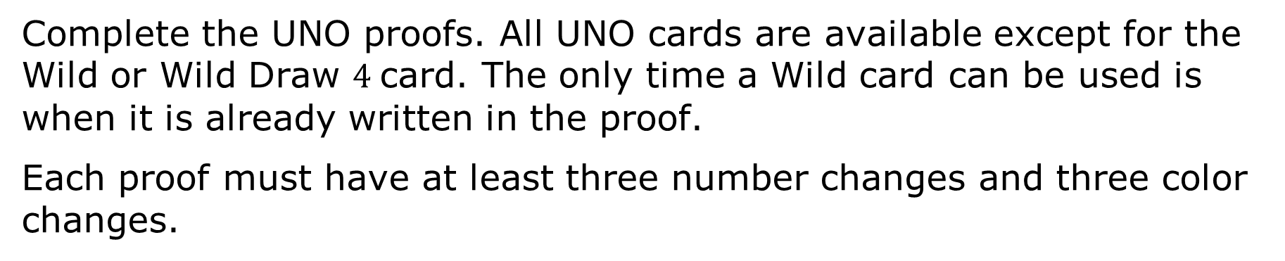
2.3.3 Activity: Taking Turns
Complete the UNO proofs. All UNO cards are available except for the Wild or Wild Draw $4$card. The only time a Wild card can be used is when it is already written in the proof.
Each proof must have at least three number changes and three color changes.
volume 1, pg. 96

Slide 17

Wrap-Up
volume 1, pg. 97

Slide 18
2.3.4 Wrap-Up: Reflection
How many of the UNO proofs did the class correctly complete?
Which steps in the UNO proof were the easiest to complete?
Which steps in the UNO proof were hardest to complete?
volume 1, pg. 97

